Slide 1
LIT
as
Supervisors

Slide 2
My keys for success in obtaining the job:
Sell yourself! Know your strengths and weaknesses and sell them both.
Know the library’s specific needs.
Have a plan.

Slide 3
Orillia Public Library Rebuilt
Increase of 66% in library memberships.
Three times the number of holds processed.
More than double the average number of people coming through the door each day now at 1000 per day
Introduction of new technologies such as the automated sorter, gate system, security and door locking systems to name a few
All accomplished with the same level of staffing and smaller budgets.

Slide 4
Biggest Challenges
Successfully managing a diverse group of personalities.
Updating procedures and policies to reflect a tighter budget, limited staffing.
Dealing with difficult situations.

Slide 5
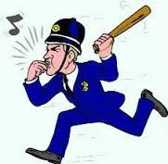
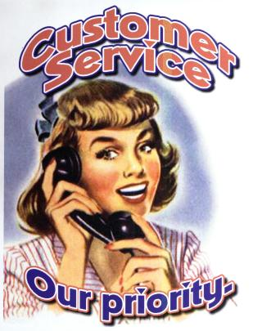
Refocusing my Department
Policing
VS.
Customer Service

Slide 6
Working with Staff
Document everything!
Value Evaluations

Slide 7
Things I Have Learned
…the hard way
Be clear with direction. Ensure that it is enforceable.
Communication! “Oh yea…didn’t I tell you?”
Don’t ask for an opinion…unless you REALLY want it.
Encouragement – don’t compliment the everyday or the expected

Slide 8
“You handled that patron really well.”
(compliments the situation)
VS.
“You have a real knack for dealing with conflict.”
(compliments the person)

Slide 9
When giving direction,
ensure that you have
a specific end goal in mind.

Slide 10
In the department?
Taking off her coat?
“Shannon needs to start getting to work on time.”
On the job?
In the building?
In the parking lot?

Slide 11
Give your Staff Tools to Work With
Can they waive fines? If so, how much and when?
Are there any ‘freebies’ they can use to assist in a possible conflict situation?
Empowerment through training.
Sharing ideas.

Slide 12
Dealing
with
Difficult Situations

Slide 13
LIT
as
Supervisors

