Slide 1
Teaching Mature Adults Technology Skills:
The Joys and the Challenges
Notes:
Learning how to teach the “over 55” crowd effectively.

Slide 2
with
Ruth Berry eServices Library Technician Georgina Public Libraries

Slide 3
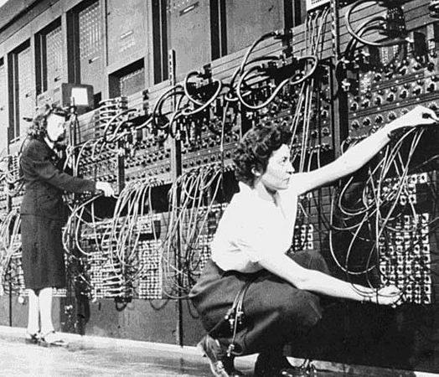
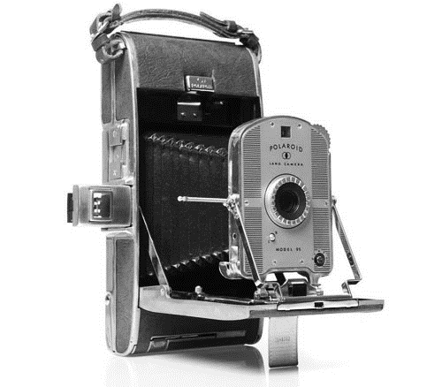
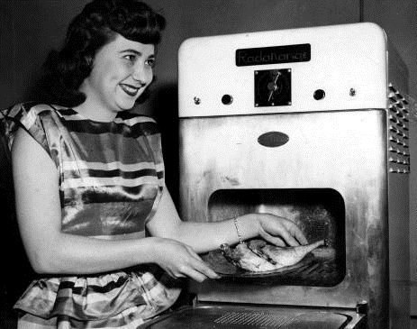
Technology seniors are familiar with: Advances in the 1940s
Advance 1940s:
y Advances in the 1940s:
Notes:
The first computer, the first Polaroid camera, and the first microwave.

Slide 4
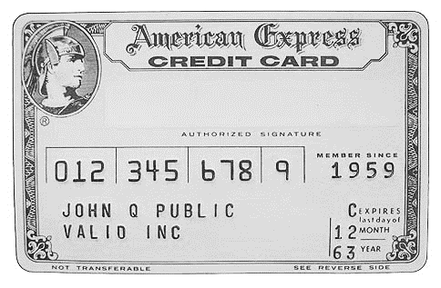
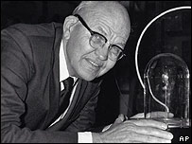
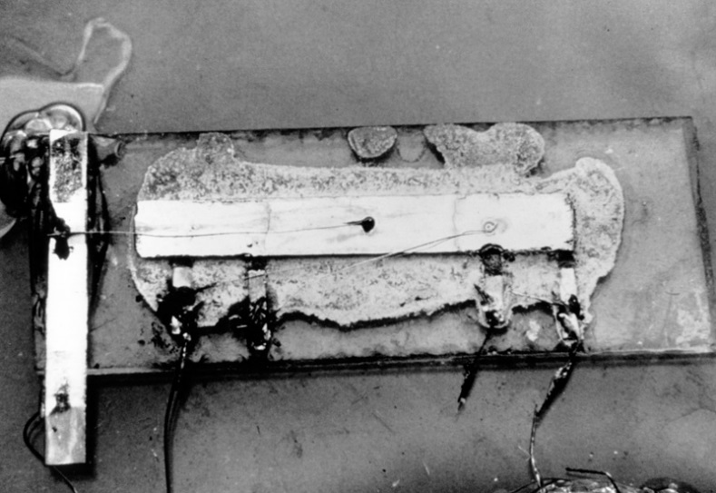
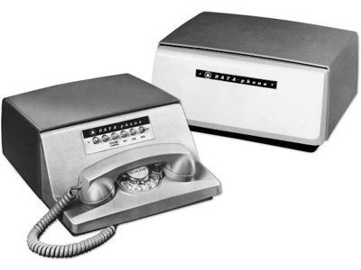
Advances in the 1950s1950’S
Notes:
Credit card
Fiber optics
Microchips
Integrated circuits
Computer modems

Slide 5
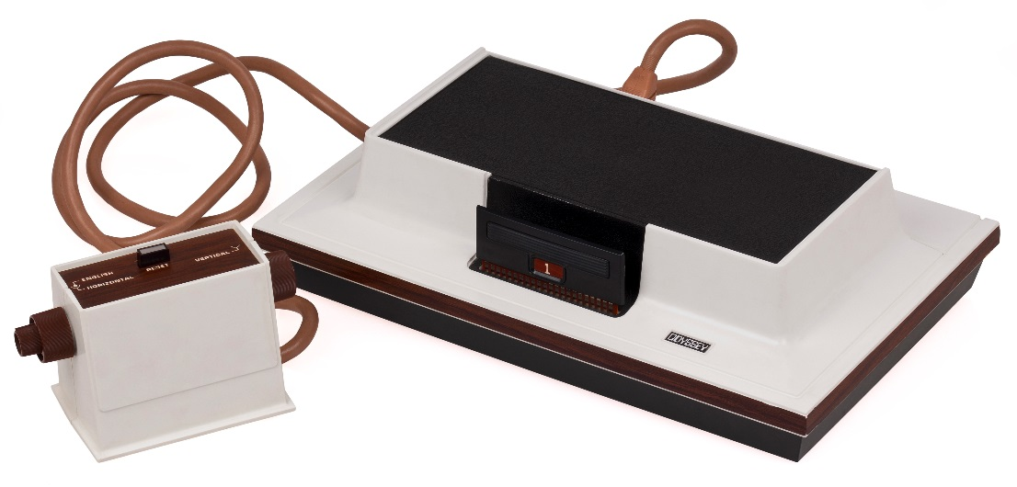
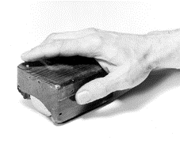
TECHNOLOGY ADVANCES IN THE 1960’S Advances in the 1960s
Notes:
Video game consoles
Computer mouse
Direct Random Access Memory

Slide 6
You need to remember:
The generations you are teaching come from the 1920’s to 1960’s
Learning new and ever-changing technology is challenging for most
Seniors are highly motivated to master new skills
An environment with an encouraging teacher = greater success
Notes:
The generations you are teaching come from the 1920s to 1960s.
Learning this “new and ever-changing technology” is challenging for most.
Seniors are highly motivated to practice and master new skills, but they are concerned about making mistakes.
A relaxed environment with an encouraging teacher allows for greater learning success.

Slide 7
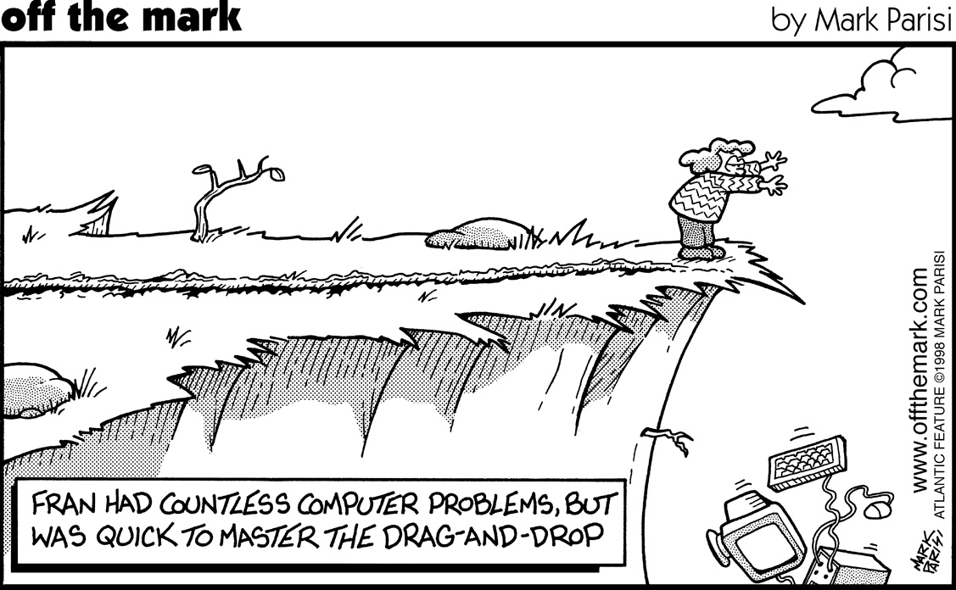
Senior surfers suffer from technophobia

Slide 8
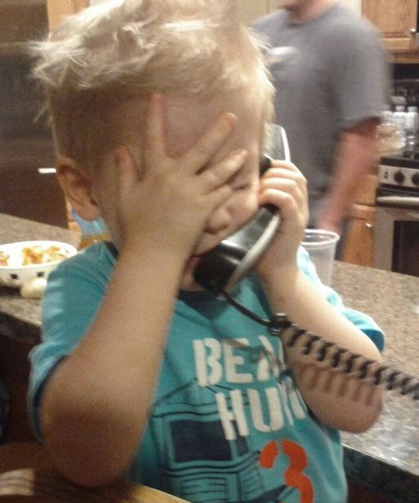
…And from impatient grandchildren…
No, Grandma, listen…
…you double-click the
Firefox icon…

Slide 9
…And impatient adult children…
I don’t understand why you don’t get it!? It’s, like, sooooo simple!

Slide 10
Why Teach Seniors Technology?
Real need to teach seniors technology that will grow as the population continues to age
Seniors will have skills to stay socially connected with family and friends
You are providing them with skills to ensure their independence
Notes:
There is a real need to teach seniors technology that is only going to grow as the population continues to age; as there are more technological advancements; and even more services that will be delivered only in an online format.
By teaching technology, you are giving seniors the tech skills to stay socially connected with family and friends and to reduce the feelings of isolation.
You are providing them with skills to ensure their independence.

Slide 11
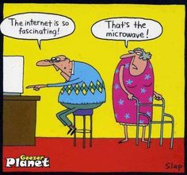
What to Teach?

Slide 12
SENIOS
RS ON
87% of senior social media users are on Facebook
Staying connected with family and friends easy for seniors
Use it to see pictures of kids and grandkids
Pressure from kids/grandkids/friends to use Facebook
1 in 5 seniors use Facebook for an hour on any given day
Notes:
Of senior social media users, 87% were on Facebook—(CBC study, 2015)
#1 reason FB is most popular--way to stay connected with family and friends and easy for seniors to navigate
To see pictures of kids and grandkids
Pressure from kids/grandkids/friends to communicate this way

Slide 13
HOW TO TEACH
Teaching: One-on-One Instruction
Ascertain from that patron wishes to accomplish
Create handouts for them and add notes as you instruct
Make sure that they understand what you have shown them
Seniors enjoy these sessions because of individual attention
Notes:
For the one-on-one tech help sessions, ascertain from that person, beforehand, what they wish to accomplish
Create handouts for them, before they arrive, and add notes as you instruct
Make sure that they understand what you have shown them and then have them show you
Seniors enjoy these sessions because of the individual attention; the ability to learn what they want to learn, and they like the fact that they know they can always return for another session or can contact me for help by email or by phone.

Slide 14
COMPUTERS FOR BEGINNERS & ONE-ON-ONE TECH HELP
Basic computer skills/Facebook
Setting up a Skype account
Online banking
Genealogy research
Transferring photos from phone to computer
Downloading eBooks and audiobooks
Online dating
Notes:
Just a sample:
Basic computer skills: keyboard and mouse skills; how to send an email; create a document; search the Internet;
Set up a Skype account
Online banking/paying bills online
Genealogy searching
Transferring photos from phone to computer
Downloading eBooks and audiobooks
Online dating

Slide 15
USEFUL TIPS FOR COMPUTER CLASSES
Useful Tips for Computer Classes
Assure your class that you will proceed in a step-by-step manner at a slow-to-moderate pace to make sure everyone grasps the information and skills with lots of hands-on practice
Do not use tech-heavy terms delivering information in small chunks
Have handouts with simple, step-by-step instructions
Ask everyone if they can hear you
Encourage them to ask questions and give praise
Remind seniors it is like learning to drive for the first time
Always watch for visual clues for anyone who is struggling
Adjust voice, computer screens, and lighting for comfort
Notes:
Do not use jargon or tech-heavy terms
Have handouts with simple, step-by-step instructions in clear, concise wording in an easy-to-read font (Arial or Helvetica) with labeled screenshots
Ask everyone if they can hear you
If there is something they don’t understand, encourage them to ask
Give praise
Remind your seniors that learning the computer is like learning to drive for the first time and how practice is the only way to get better
Always watch for visual clues, while teaching, for anyone who is struggling or wants to ask a question
Adjust voice level, computer screens, and room lighting for maximum comfort

Slide 16
The Challenges: Never Assume Anything
Seniors may be unfamiliar with the simplest computer tasks
Seniors have trouble handling a mouse
One senior held the mouse in the air
Seniors having trouble seeing the computer screens
Senior nodding to everything, but actually can’t hear
Seniors that cannot read or write
Notes:
Sample Beginners Computer Classes Experience: Never Assume Anything
Seniors may be completely unfamiliar with even the simplest computer tasks
Seniors overwhelmingly have trouble handling a mouse
One senior held the mouse in the air while trying to click it and move it around—had never used a mouse before in her lifetime
Seniors having trouble seeing the computer screens—bifocal and reduced vision issues and room lighting
Hearing issues--senior nodding to everything but couldn’t hear what was being said—didn’t want to say and be a bother
Another senior could not read or write

Slide 17
Other Challenges
Majority have technophobia
Limited tech literacy skills
Induced anxiety from bad experiences
Feel pressure to jump on the bandwagon
Language/accessibility barriers
Some cannot afford internet access
Limited physical capabilities
Classroom lighting and vision problems seeing screen
Memory retention
Notes:
Majority have technophobia
Limited tech literacy skills
Induced anxiety from bad experiences with family members/spouses
Feeling pressure to jump on the tech bandwagon
Language/accessibility barriers
Some cannot afford Internet access
Limited physical capabilities, i.e. arthritic hands—moving mouse
Classroom lighting and vision problems seeing computer screen
Memory retention

Slide 18
The Joys
75 years old
80 years old
89 years old
92 years old
Notes:
My One-on-One Tech Help Experiences
75 year old wants to learn how to use Skype in order to connect to a niece in Italy so he can see her new baby
80 year old, whose macular degeneration is getting worse, wants to learn how to download audiobooks
89 year old is given an iPad for his birthday and wants to learn how to use YouTube so he can watch his barbershop quartette perform
92 year old patron wishes to learn Windows 10 on her brand new laptop in order to send email to 105 year old sister in Ireland who is pressuring her to “get with it”.

Slide 19
Web Resources to Get You Started
Techboomers
https://techboomers.com
Webwise:
www.bbc.co.uk/webwise/0/
GCF LearnFree
www.gcflearnfree.org/topics
Meganga
meganga.com/
Microsoft Accessibility
www.microsoft.com/enable/aging/tips.aspx

Slide 20
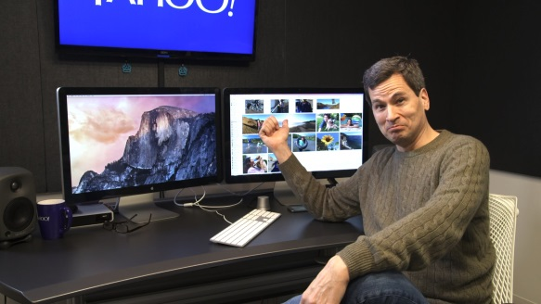
Where to Find Tech Tips and Trends
techradar.com
cnet.com
Notes:
Keeping up with trends and new technologies will help you be better prepared for your senior patrons.
Suggestions:
http://pogueman.tumblr.com/
http://www.theverge.com/
http://readwrite.com/
http://www.techradar.com/
http://www.cnet.com/
http://techland.time.com/

Slide 21
Ruth Berry
rberry@georgina.ca
905.476.5762 ext.4520
@librerry

