Slide 1
Creating Your Professional Portfolio
Maggie Weaver
Shaftesbury Associates
OALT/ABO Conference,
Algonquin College, May 2017

Slide 2
What
A tool for students to track and record their learning experiences, to identify transferrable skills and to use for job search – Career Portfolio
Concrete proof of skills & learning
An opportunity for creative self-expression
To use in job interviews
And also
A tool for unifying contract experience
A tool for realigning experience & skills before career change

Slide 3
Why
To use in job interviews
And also
For career development – to identify new skills required
In career planning & change – to identify transferrable skills
A promotional tool in performance appraisal
A prior learning assessment tool, as part of a certification process

Slide 4
So, a portfolio is . . .
A collection of samples
demonstrating your skills
A collection of documents
showcasing your accomplishments
A support package
A résumé tells, a portfolio shows
A self-development tool
A self-marketing tool

Slide 5
A professional portfolio becomes . . .
A visual showcase: a collection of documents, artifacts, images or materials
A career showcase: a concrete reflection of who you are, who you hope to become, and what you hope to achieve in your career
An archive: documentary evidence of your work and learning history; of your skills, interests and abilities; and feedback from others
A process: identify and reflect on what motivates and satisfies you – your interests, skills, values, needs and goals.

Slide 6
What might be in the portfolio?
Skills inventory
Transcripts for academic qualifications
Certificates for technical skills (e.g. computers, languages)
Samples of creative skills
Testimonials from community and volunteer work
Job descriptions
Lists of accomplishments
Awards and honours
Photographs of success
Published works, conference papers, journal articles
Professional development activities, associations

Slide 7
What does it look like?
A scrapbook }
A binder } reactive
A file box or cabinet }
A website }
A brochure } promotional
A business plan }
A project proposal }
A functional résumé } targetted
A business pitch }

Slide 8
Build your portfolio
Personality }
Strengths }
(with a buddy) }
Motivation / interests }
Values
Skills }
(with a buddy) }
http://www.edu.gov.mb.ca/k12/docs/support/c_portfolio/part1.pdf
https://www.careerwise.mnscu.edu/iseek/static/MnCareers2010assessment.pdf
http://www.conferenceboard.ca/topics/education/ learning-tools/employability-skills.aspx http://www.ala.org/educationcareers/careers/ corecomp/corecompspecial/knowledgecompetencies

Slide 9
Build it: Personality
Check off the adjectives you feel best describe you…
Circle your top 10
Summarize: Write a proof statement about each (for now, just one) e.g.
EAGER: “I plan for the next activity before the current one is done”
SELF-RELIANT: “By choice, I’ve been self-employed since 2002”
http://www.edu.gov.mb.ca/k12/docs/support /c_portfolio/part1.pdf

Slide 10
Build it: Strengths
Check off the statements that apply to you…
Circle your top 5
Summarize: Write a proof statement about the key strength
e.g.
I like to solve puzzles, I like to organize things,… so
I have logic strengths: “I have developed workshops, organizing material in a sequence that is easy to follow and to learn”
http://www.edu.gov.mb.ca/k12/docs/support /c_portfolio/part1.pdf

Slide 11
Build it: Motivation / interests
Check off your strongest interests
Find your “interest profile”:
Artistic: focus on ideas and people
Enterprising: focus on people and data
Investigative: focus on ideas
Organizer: focus on data and thinking
Realistic: focus on things
Social: focus on people
https://www.careerwise.mnscu.edu/iseek/static/ MnCareers2010assessment.pdf

Slide 12
Build it: Values
Abilities
Advancement
Aesthetics
Authority
Autonomy
Creativity
Economic reward
Environment
Intellect
Prestige / status
Service
Social interaction
Risk taking
Variety

Slide 13
Build it: Skills
Employability Skills 2000+ (Conference Board) http://www.conferenceboard.ca/topics/education/ learning-tools/employability-skills.aspx
Library competencies http://www.ala.org/educationcareers/careers/ corecomp/corecompspecial/knowledgecompetencies
Write a proof statement to go with each skill
For each specialized skill, create a feature page

Slide 14
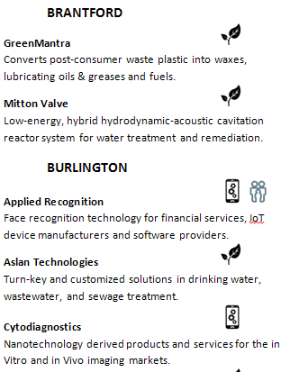
e.g. Feature page: research skills

Slide 15
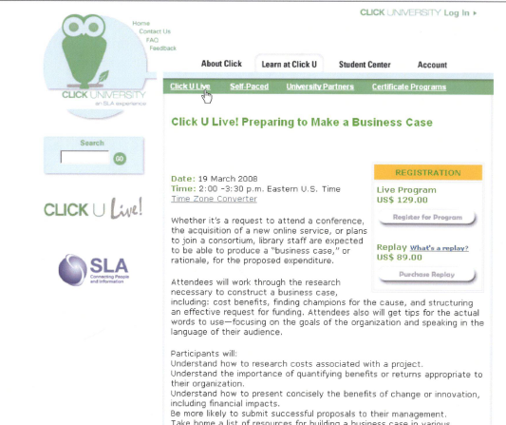
e.g. Feature page: training skills

Slide 16
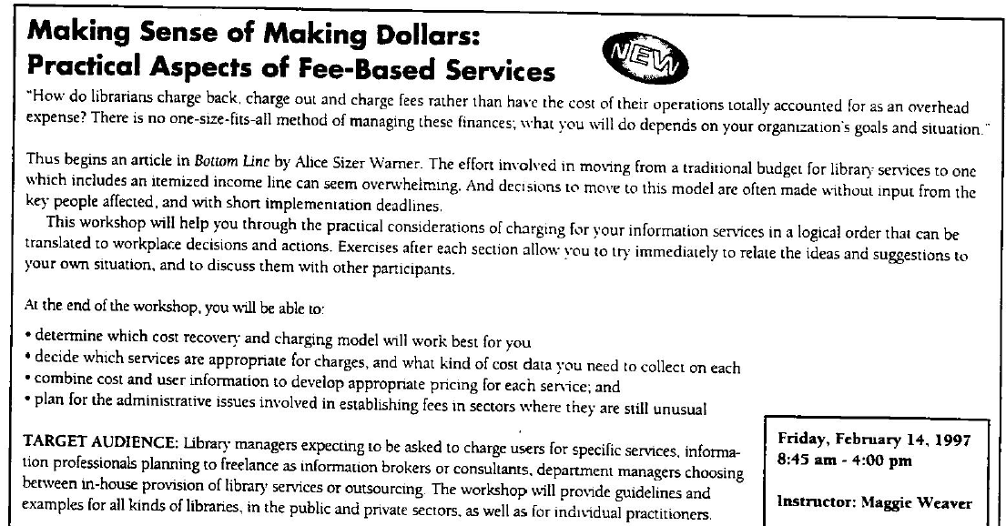
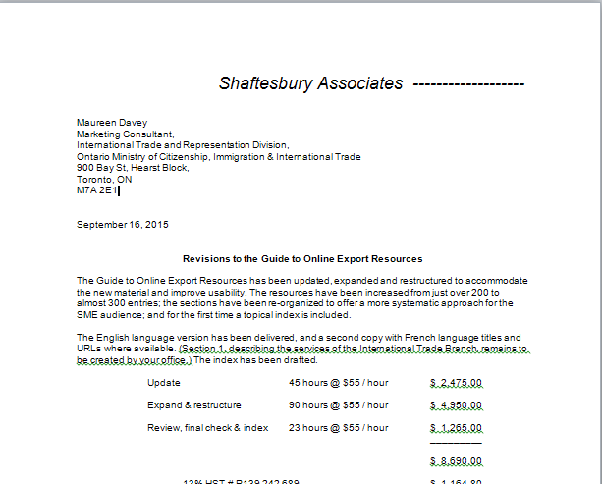
e.g. Feature page: business skills

Slide 17
SKILLS
Fundamental skills
Communicate
Manage information
Use numbers
Think and solve problems
Personal management skills
Demonstrate positive attitudes & behaviours
Be responsible
Be adaptable
Learn continuously
Work safely
Teamwork skills
Work with others
Participate in projects and tasks

Slide 18
e.g. SLA Competencies…
Core competencies:
Sharing best practices and experiences, professional excellence, ethics
Managing information organizations
Managing information resources
Managing information services
Applying information tools & technologies
Personal competencies:
Opportunities, big picture, communication, negotiation, partnerships, values, teams, risks, planning, creative, professional networking, “demonstrates personal career planning”, work-life balance, flexibility, celebrates achievements

Slide 19
e.g. overlooked skills / accomplishments
All volunteering…
…demonstrates values, and use of skills
All creations…
…are tangible evidence of personality and skills, whether balanced budgets, newsletter articles or knitting
All courses…
…have assignments and projects that are tangible evidence of comprehension
All parents…
…have learned decision-making, negotiation, handling difficult situations

Slide 20
Your turn…
Find out just ONE skill that your neighbour has, that you don’t have
“that’s easy” doesn’t mean “that’s not skillful”
(not everyone can knit, or speak in public, or write fiction, or plan a wedding)
Think of one NEW skill (or knowledge)
that will help you in your current job, or a future job, or towards a long-term goal

Slide 21
Use your portfolio…
As a “database” of all your experience – not just work-related
As a “showcase” of relevant experience
To identify your talents
To plan a career change
To figure out why you’re bored in your current job
To describe projects you’d like to work on
To explain a disjointed work history
To write a functional résumé
To plan for a very different future workplace

Slide 22
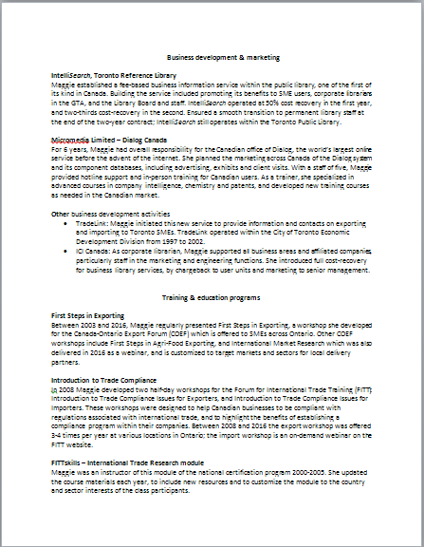
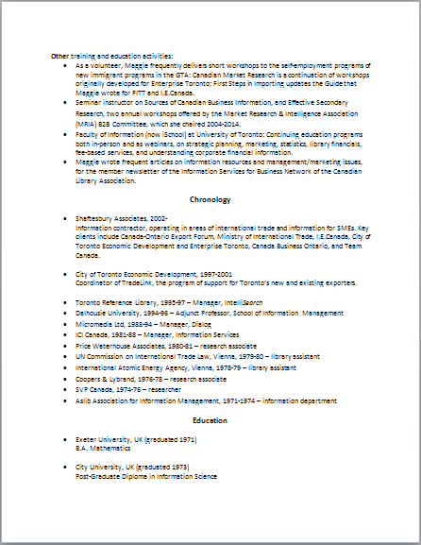

Slide 23
Use your portfolio…
and to answer these questions…
What do I want to do / learn next?
Why should we keep / promote you?
Tell me about yourself?
How are you qualified for this job?
Why should we grant you credit for your prior learning experience?
Why do you deserve this scholarship / award?
Why should we give you a business grant / loan?
Why should we contract you to deliver these services?

Slide 24
In the short term
Only you can
Document your skills and strengths
Add to your skills and knowledge
Market yourself effectively
As you work on your portfolio, you’ll get to know yourself very well
Feed your portfolio regularly
Pat yourself on the back each time
Browse through occasionally …it’s very reaffirming

Slide 25
In the long term
A résumé outlines your past
A portfolio is a roadmap to your future

Slide 26
https://www.careerwise.mnscu.edu/iseek/static/MnCareers2010assessment.pdf

