Slide 1
Federal Science Library presentation to 2017 Ontario Association of Library Technicians (OALT) Conference
Lynne McAvoy
Chief, Federal Science Library
May 11, 2017

Slide 2
Agenda
Describe the Federal Science Library (FSL) partnership
Share our achievements
Outcomes and opportunities
FSL Portal

Slide 3
Federal Science Library Vision
FSL Participants collaborate to ensure that researchers, program planners, knowledge workers, and policy makers have virtual, instant access to both high quality information resources and the services of skilled and knowledgeable information professionals
From: FSL Memorandum of Understanding

Slide 4
Federal Science Library Initiative
Federal Science Library Initiative
is a collaboration of 7 Government of Canada (GC) science libraries providing discovery and access services to their print and electronic holdings through resource-sharing, joint management of common services and cooperative delivery of reference services
has successfully transformed government business through technology; enhancing access for ~45K GC knowledge workers to global information resources that fuel scientific innovation, program and policy research
demonstrates a cost-effective and scalable service delivery model supporting progress towards a whole-of-government approach for library and information services for GC employees that will also provide increased visibility and access to GC print and electronic science library collections by Canadians. (NB: Open Government Action Plan 2.0 commitment - Open Information core commitment)

Slide 5
FSL Partnership

Slide 6
FSL: Brief history
2000 | Federal S&T libraries Community of Practice (CoP) formed
2010 | Federal Science eLibrary (FSeL) - E-journal licenses negotiated by NRC-CISTI for 5 departments
2011 | Science Cluster Information and Library Services (SCILS) - CoP defines new ‘cluster’ for shared information and library services
2012 | Federal Laboratory Integrated Governance (FLIG) - NRC and NRCan ADMs agree to sponsor SCILS
2013 | SCILS design and business case developed
2014 | Federal Science Library (FSL) – initiation of the NRC-led project formerly known as SCILS
2015 | ADMs signed Master MOU; DGs signed project implementation agreements with NRC to fund & participate in FSL; procurement complete; technical build started.
2016 | Wave 1 onboarded (NRC, HC, AAFC); interim operations established; Wave 2 onboarded (NRCan, PHAC, EEEC, DFO); FSL operations model finalized; staff deployed; FSL Chief hired; public site developed; transfer to operations initiated.
2017 | Launch of FSL Public Site; operations stabilized.

Slide 7
FSL project achievements 2014-2016
2014-15:
MOU signed by all 7 FSL participants
Built core project team and multiple partner working groups
Procured cloud-based shared integrated library system (Innovative Sierra ILS) and Discovery (ProQuest) licenses
Confirmed business requirements
2015-16:
All participants signed Implementation agreements for sharing project costs
Configured Discovery tool and activated departmental e-resource subscriptions
Built Web portal for each department
Configured a shared integrated library system
FSL operations costing model and funding model was approved
Participated in Open Science 2.0 discussions

Slide 8
Achievements 2016-2017
2016-17:
Completed library system data migration for all partners
Launched FSL Web portal for each of the seven partners
Number of internal clients who have access: 46,872
Developed a public Federal Science Library site that launched March 6, 2017
Staffed FSL Chief position and established FSL operations team
Developed Agreement for FSL Operations
FSL Project transitioned to FSL Operations in April 2017

Slide 9
Collaborative Governance and Operations
Approach:
Bilateral agreement between NRC (as FSL host) and each participant
FSL governance structure and FSL operations aligned
DG Steering Committee
Director-level Management Oversight Committee
Process established for annual financial planning, approvals, and revisions
Funding model:
Implementation costs supported by individual partner departments (expenditures and in-kind)
operations costs shared by all
Performance indicators:
Standards established for FSL service desk
Monthly performance reporting

Slide 10
FSL Operations Structure
FSL DG Steering Committee
(FSL DG SC)
FSL MOU 7.2.1
FSL Management and Oversight Committee (FSL MOC)
FSL MOU 7.2.2
FSL Operations Advisory Committee
(FSL OAC)
FSL Operations
(FSL OPS)
FSL MOU 7.3.1
FSL Client Advisory Panel
(FSL CAP)
FSL Participant Operations

Slide 11
FSL Operations Organization Design
Chief, Federal Science Library LS-5
Technical Lead
CS-3
Administrative Coordinator
AS-2
Library Systems Administrator
LS-4
Systems Support Librarian
LS-3

Slide 12
FSL Applications and Systems
“If something is not discovered, it has no chance of being used”
Common integrated Library System (ILS)
Common e-Resource Management System
Common Search Engine Portal
A series of inter-dependent modules which inventory and describe materials in the physical collection. Supports workflows for purchase, loans, reserves and managing checkout and requests
Vendor-supplied knowledgebase contains article level metadata provided by publishers. Libraries purchase and activate these publications by flagging a resource as searchable and linkable. Statistics modules help support usage tracking and subscription decisions.
Leverage library discovery technology that allows clients to find and access information resources from multiple science-department sources through a single centralized web-portal

Slide 13
Vendor-hosted cloud-based solutions
FSL leverages mature vendor-hosted solutions and services.
Web Scale Discovery Search Engine
Integrated Library System
Shared library business system
Subscribed Content Knowledgebase
eResource Aquisitions
Optional Member Licensed
Direct Access Content - Link Resolver
Interlibrary Loan
Remote Access
Chat
Messaging
Document
Delivery
Service

Slide 14
FSL Resources
A vast collection of publications in science, technology, engineering and health and other related economic, policy and program information
Total combined catalogue items = 2,889,728
Open access databases and
e-subscriptions (journals, books,
databases available to staff)
= 1,268,345
Repositories indexed:
Geoscan: 75,291 records
NRC Publications: 53,704 records
Canadian Forestry Services: 27,858 records
Potential to index other repositories (e.g. Depository Services Program)
Access to Summon knowledgebase beyond FSL = 2 Billion citations
Notes:
Open access databases, e-subscriptions by department:
AAFC: 662,472
ECCC: 55,939
HC: 178,845
NRC: 131,428
NRCan: 33,616
DFO: 368,517

Slide 15
Appendix: FSL Public Site Demo
Web site metrics (Feb. 27-April 5, 2017)
Over 14,475 sessions and 31,679 pages viewed. After an initial surge on March 6, activity is settling into a steady usage pattern, with expected dips indicating weekends.
New visitors (65.1%) outnumber returning visitors (34.9%)
81.4% of session originate in Canada; 7.63% in the US
82.31% of sessions in English; 12.32% in French
“Climate change”; “flu vaccine”; “transportation” are the top searches

Slide 16
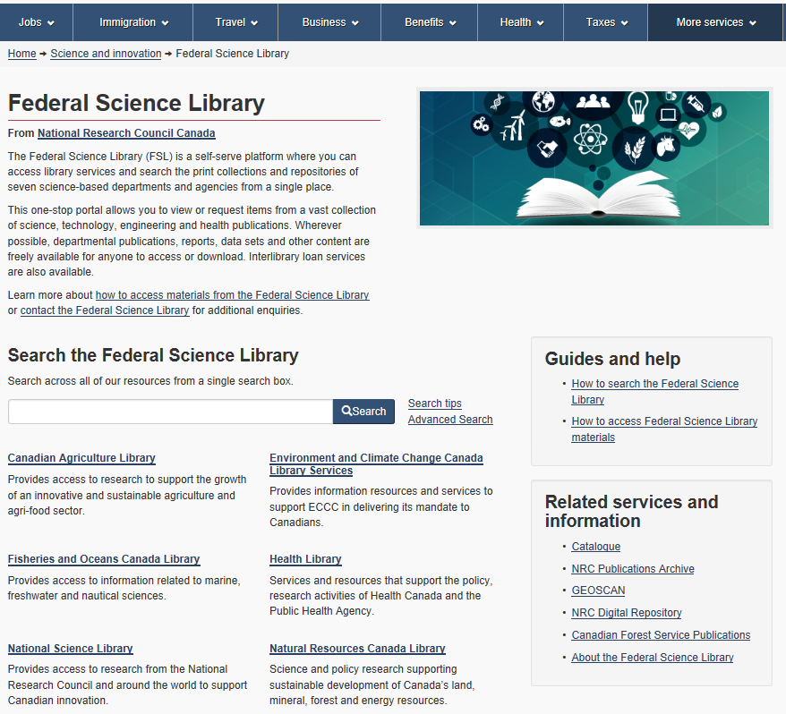
Home page navigation
Gives prominence to our discovery tool which provides First search capability that provides relevancy ranked results from a single search are retrieved from:
Public catalogue – contains records from the seven FSL science libraries
Our indexed repositories: GEOSCAN, NPARC, CFS…. eventually Publications.gc.ca
Curated list of science-based Open Source databases
Promotes our member libraries and provides navigational links to their page
Provides links to our most important repositories and our help pages
1
2
3

Slide 17
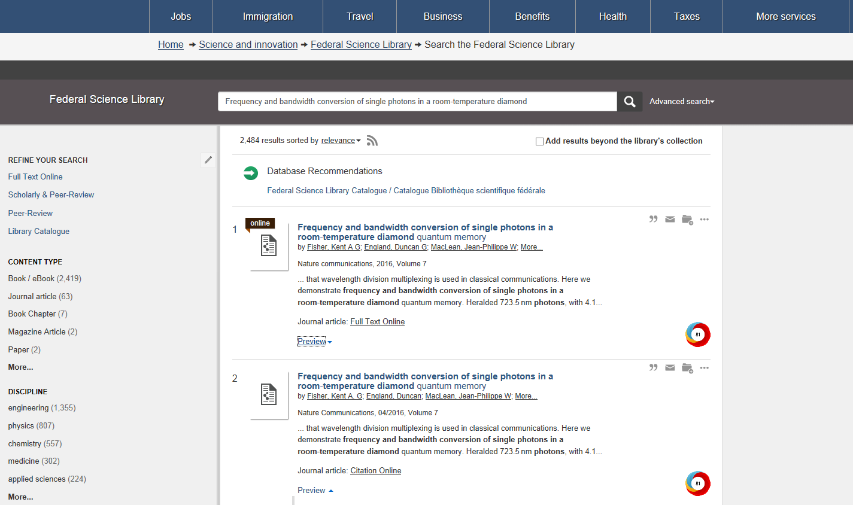
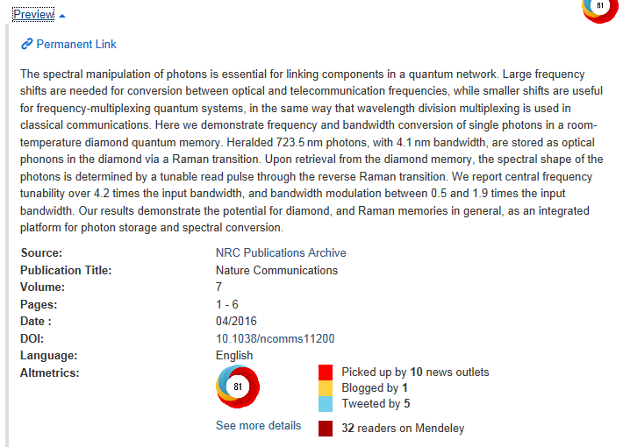
Summon search results page
1
2
Discovery tool embraces Amazon and e-Bay like filtering/discovery tactics
Tools to save citations to a temporary folder for export or email
Pulls meta data from the repository to help the client determine whether they are interested in the document
Altmetrics – provides links and information to social media commentary on the document in question - Researchers can see how others are using/citing a document.
3
4

Slide 18
FSL usage – Sample Google Analytics Report

Slide 19
Contact information
Lynne McAvoy
Chief, Federal Science Library National Research Council Canada
Government of Canada
Lynne.McAvoy@nrc-cnrc.gc.ca
Tel: 613-998-7184 / Cell: 613-240-2166

